Slide 1

Materialize CSS
Programación de Aplicaciones Interactivas
Rafael Cala alu0101121901@ull.edu.es
David Valverde alu0101100296@ull.edu.es

Slide 2
Content
Materialize
What is Materialize?
Features
Origin
Framework
What is a framework?
Why to use a framework and not your own code?
Why Materialize and no other framework?
Material Design
GRID
First Steps
Examples

Slide 3
Materialize CSS

Slide 4

Materialize CSS - What is it?
It is a CSS Framework
Guided by Material Design from Google
Offers a good CSS and JS basis for our webs
Colors, tables, icons, floating buttons, forms...

Slide 5
Materialize CSS - Features (I)
Pretty good documentation (Materialize Documentation)
Doesn’t depend on JQuery
Relatively light (140kB CSS + 180kB JS)

Slide 6
Materialize CSS - Features (II)
Supported by a great amount of browsers
Follows good practices

Slide 7
Materialize CSS - Features (III)
Uses ECMAScript 5 terminology
Partially supported by Internet Explorer 10 and 11

Slide 8
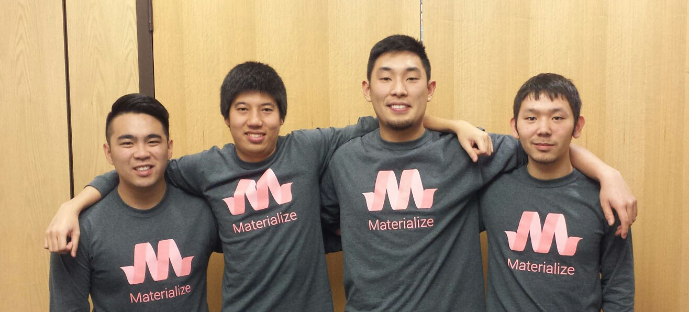
Materialize CSS - Origin
It was developed in 2014 By a 4-student team from the Carnegie Mellon University (Pennsylvania)

Slide 9
Framework

Slide 10
Framework - What is it?
It is a standard set of concepts, practices and criteria to focus on a specific type of problem
Materialize is no more than a set of predetermined interfaces

Slide 11
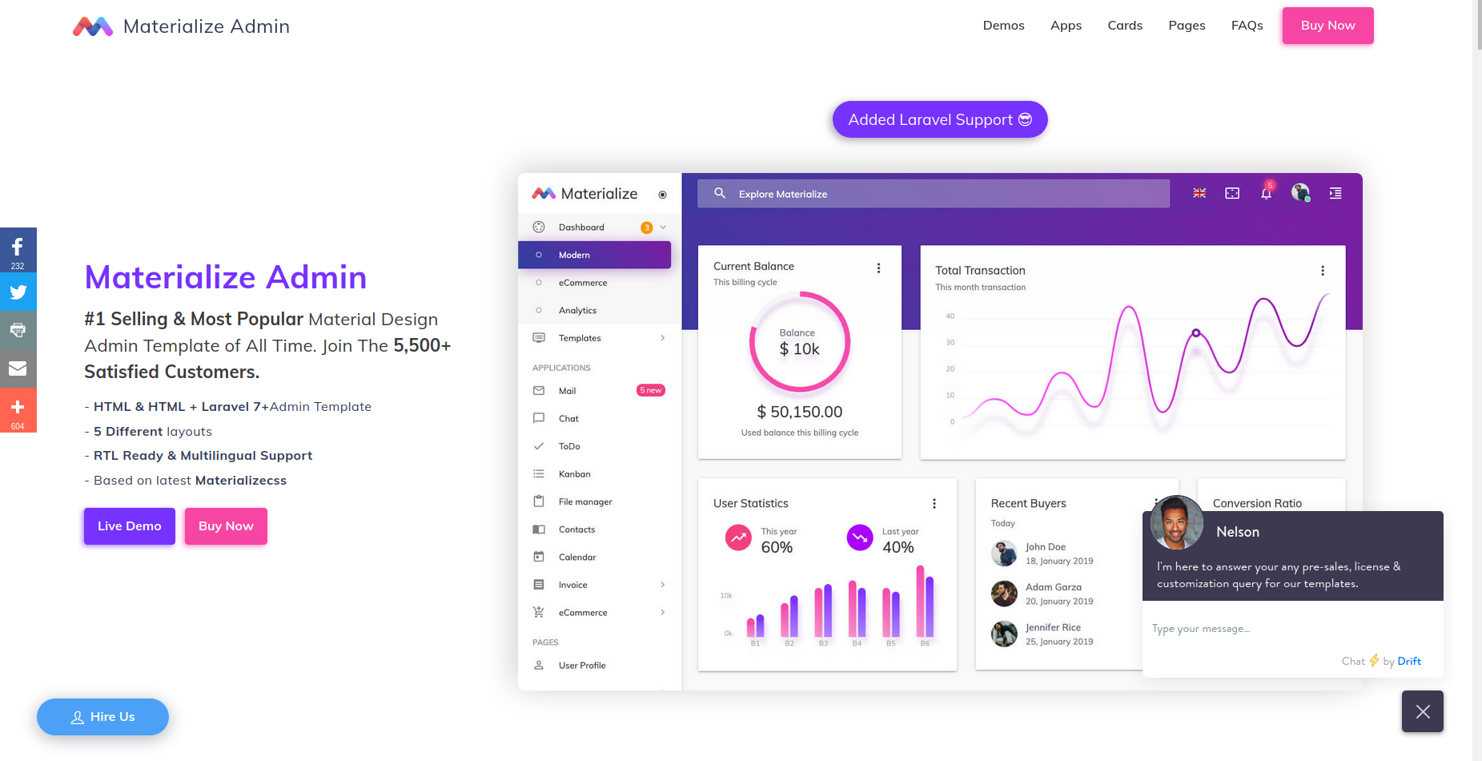
Framework - Why not your own code? (I). Advantages
It allows us to save time
It gives us an attractive aesthetic for our projects
Consistency

Slide 12
Framework - Why not your own code? (II). Advantages
Avoid to repeat code
Good practices
It gives quality to our project

Slide 13
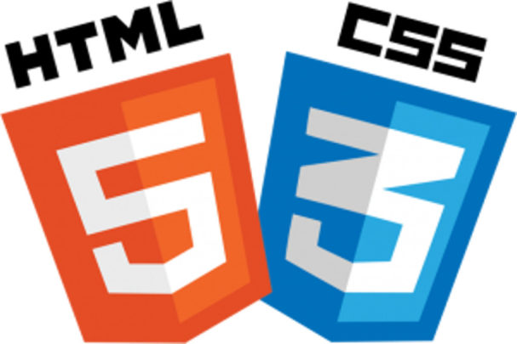
Framework - Why not your own code? (III). Disadvantages
Unused code
You must learn to use the framework. Not easy

Slide 14
Framework - Why not your own code? (IV). Disadvantages
Content and presentation get mixed
You don’t learn to defend yourself

Slide 15
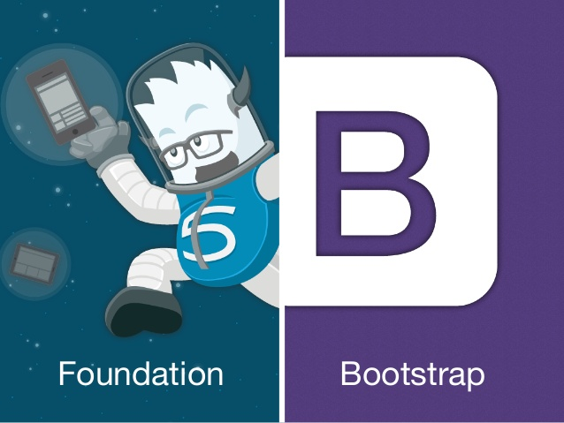
Framework - Why Materialize?
It doesn’t depend on JQuery
Based in good practices since the beginning
More familiar and easier to use
Visual interface design basics

Slide 16
Material Design

Slide 17

Material Design
Created and designed by Google.
Combines the design principles with innovation and technology.
System of design that allows for a unified user experience.
It’s thought of in the physical world.

Slide 18
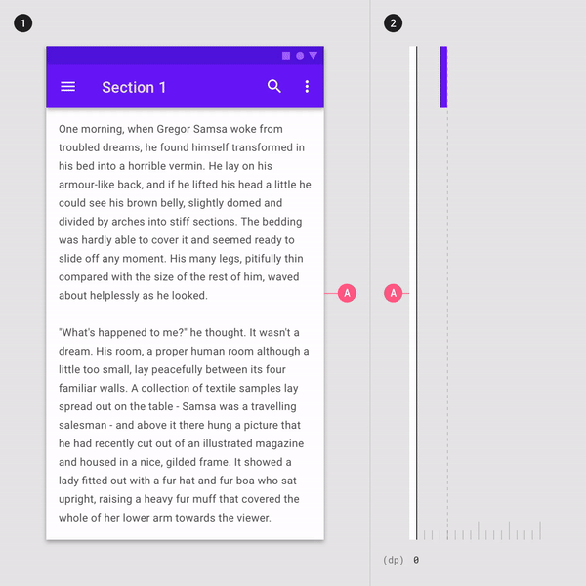
Material Design - Examples (I)
The interaction with the objects seen on the screen gives a sensation of light, surface and movement.

Slide 19
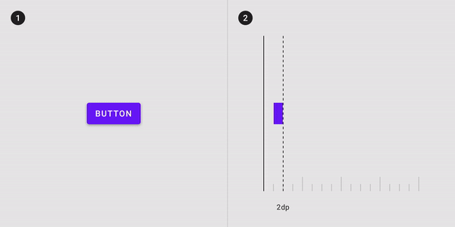
Material Design - Examples (II)
It is the button that lets us know in a physically realistic way that it is being pressed.

Slide 20
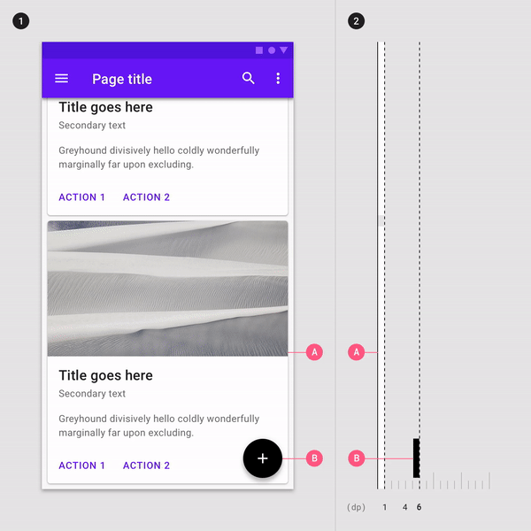
Material Design - Examples (III)
Sometimes it is the user who directs the movement

Slide 21
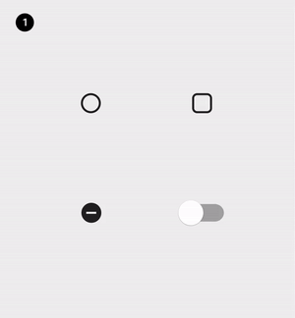
Material Design - Examples (IV)
Aesthetic coherence in the animations.

Slide 22
Material Design
“Animations are not something that interrupts the user experience, but instead enriches and gives meaning to the experience itself.”

Slide 23
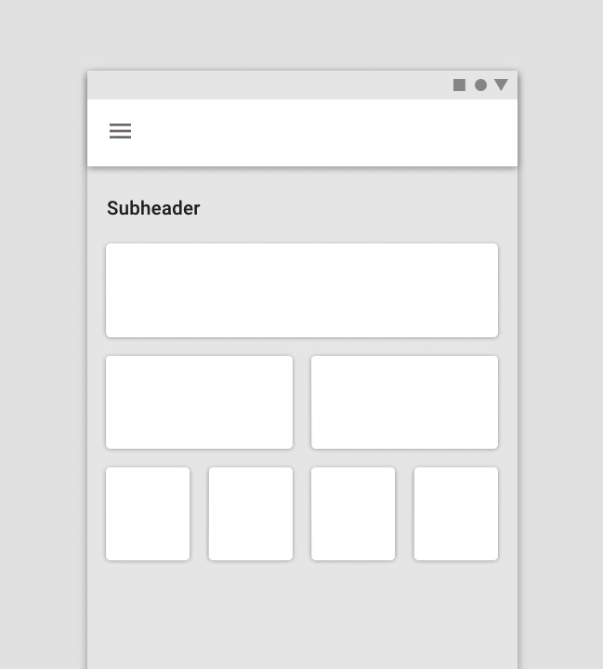
Material Design
Hierarchy and visual reading
Color
Spacing
Typographical hierarchies
Grid

Slide 24
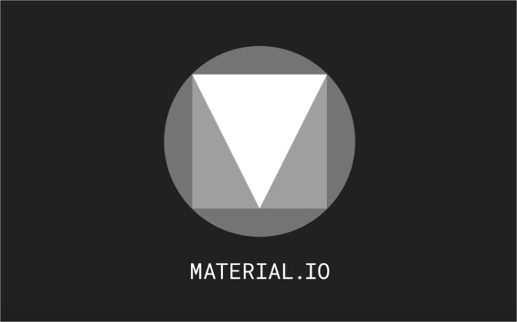
Material Design
Material.io

Slide 25
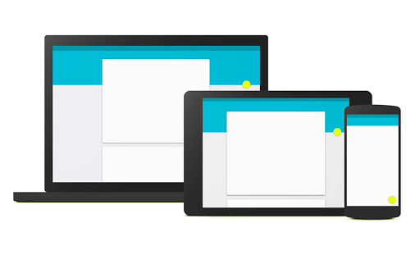
Material Design - Strengths
Adaptability
Simplicity and minimalism

Slide 26

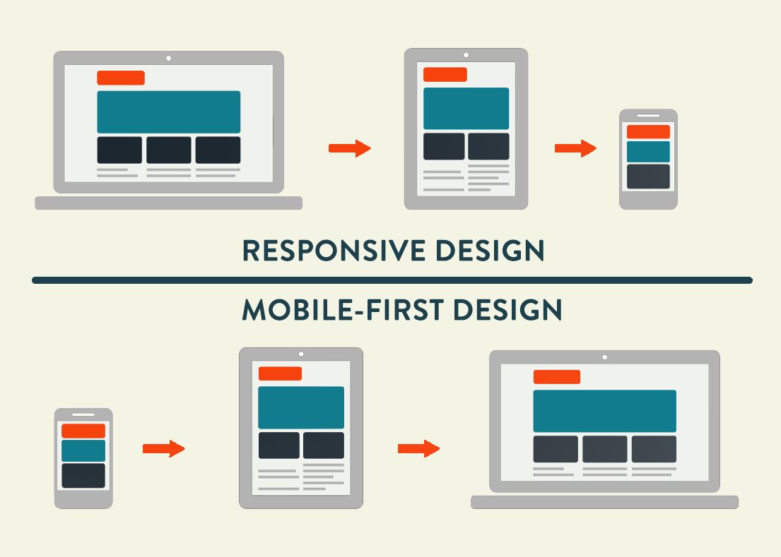
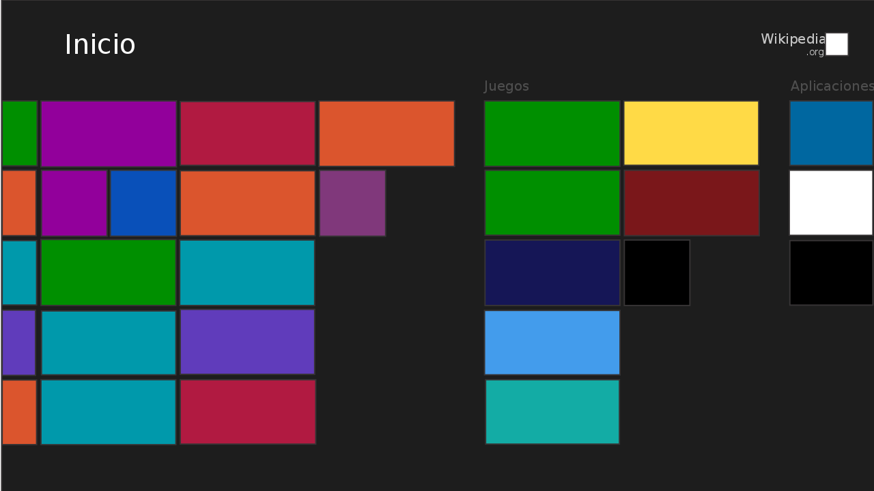
Material Design - Other web design examples
Flat design
Mobile first design
Modern design

Slide 27
GRID

Slide 28
Grid
Is a grid or structure on which elements of the page are laid out or positioned.
Helps the webpage design to be carried out in an orderly and relatively simple way.
It has rows in which there are 12 columns.

Slide 29
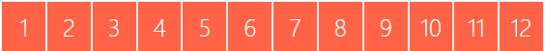
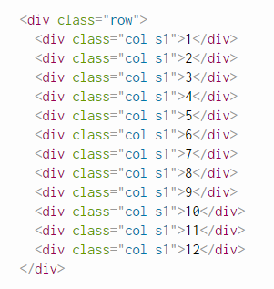
Grid
There are countless ways to combine the column layout!

Slide 30
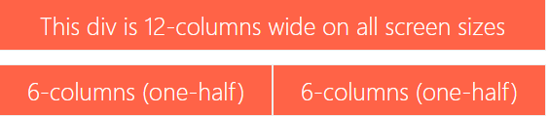
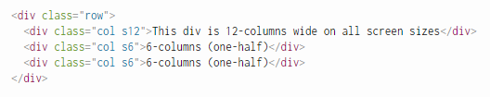
Grid
If the sum of the columns of two containers is greater than 12, the second container will be placed under the first one.

Slide 31
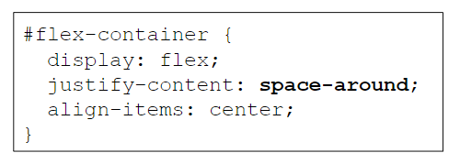
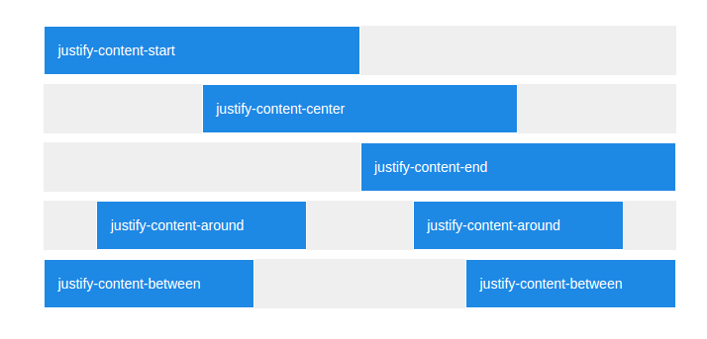
Grid
Materialize doesn’t use “justify-content”
Materialize uses Offset, Push and Pull.

Slide 32
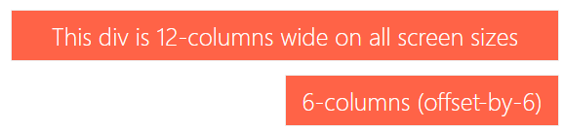
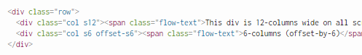
Grid - Offset

Slide 33
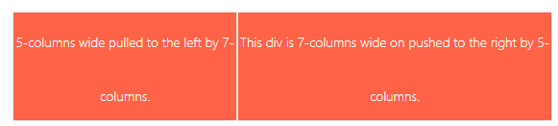
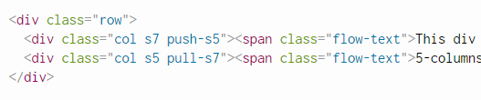
Grid - Push & Pull

Slide 34
Grid - But… Aren’t Offset and Push the same?
No. Since Offset uses margin-left, and push uses left:
Offset will force neighboring columns to move.
Push (and Pull) will overlap other columns.

Slide 35
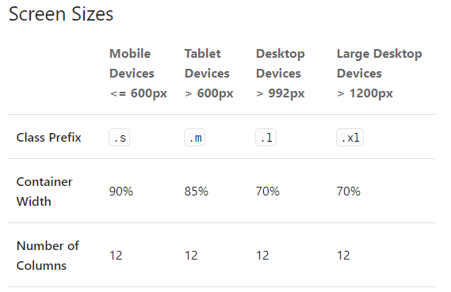
Grid - Responsive
With responsive design we are able to adapt our site to all devices.

Slide 36
Grid - Responsive
We said that ‘s’ is class prefix corresponding to the resolution of mobile devices.
So… Why has this distribution been applied to higher resolutions?
This is because the rules propagates upwards.

Slide 37
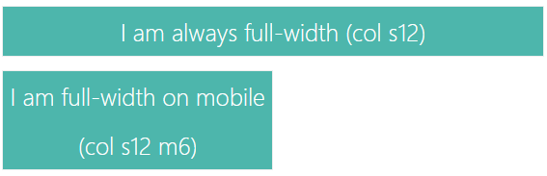
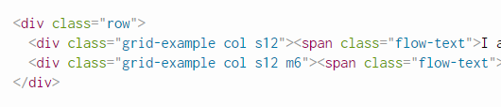
Grid - Responsive
By just saying s12, we are essentially saying "col s12 m12 l12".
But by explicitly defining the size we can make our website more responsive

Slide 38
First Steps

Slide 39
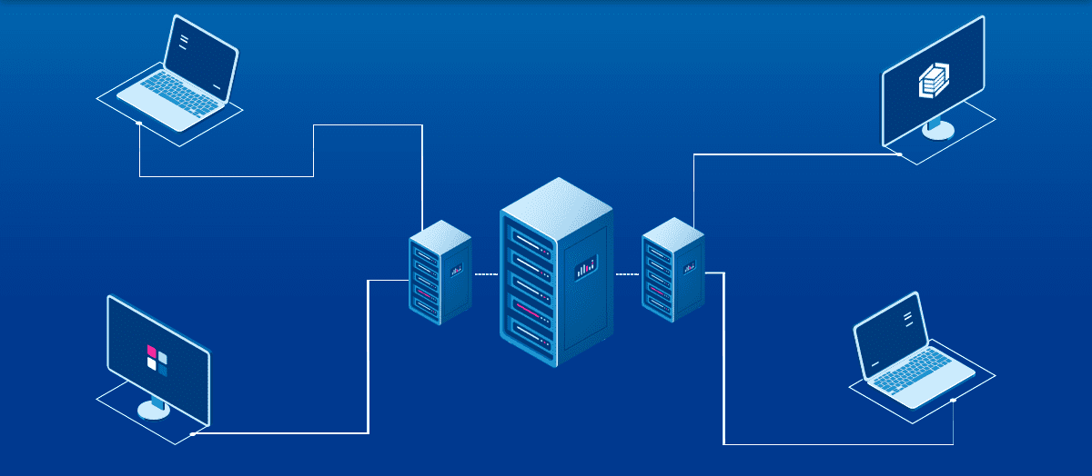
First Steps
The first thing we must do is to include Materialize in our project:
Materialize comes in two different forms
Standard Version
SASS
Two ways to include it:
Downloading CSS and JS files
Via CDN

Slide 40
Examples

Slide 41
CSS

Slide 42
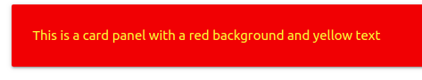
Examples - Colors
Materialize Colors
01-colors.html

Slide 43
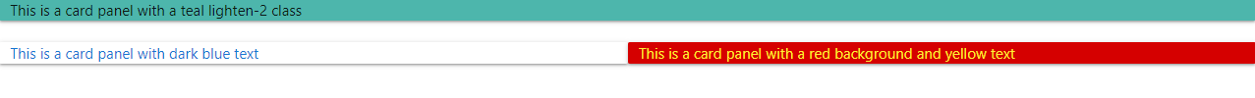
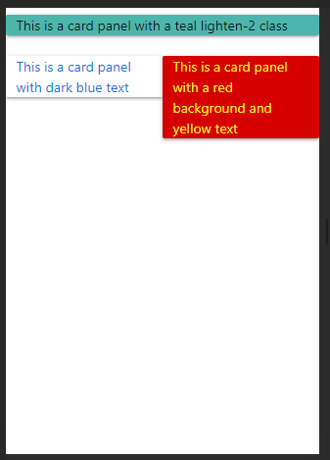
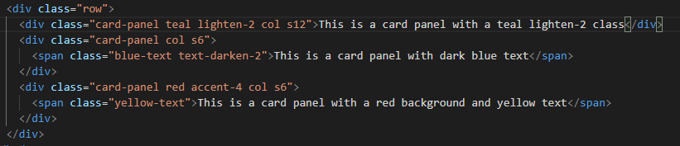
Examples - Grid (I)
Materialize Grid
02-grid.html

Slide 44
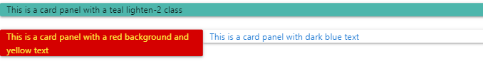
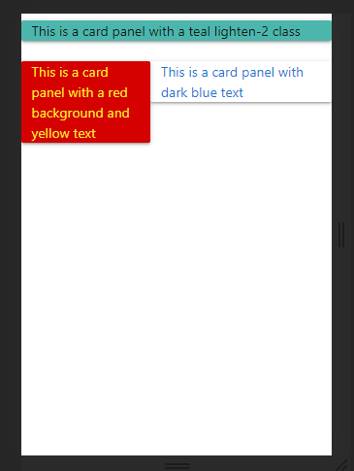
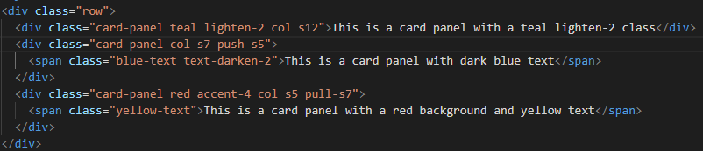
Examples - Grid (II)
Materialize Grid
03-grid-push-pull.html

Slide 45
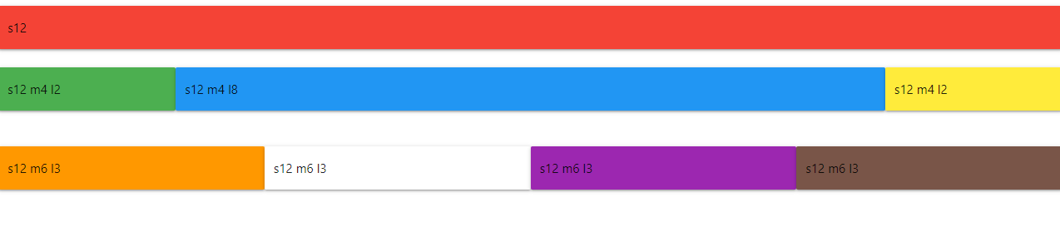
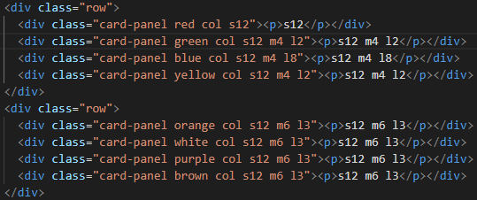
Examples - Grid (III)
Materialize Grid
03-grid-responsive.html

Slide 46
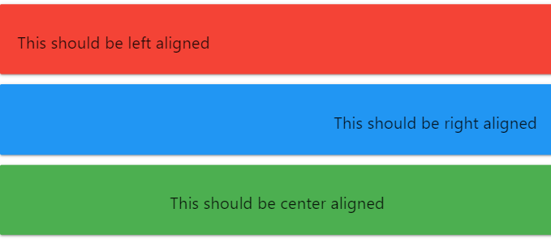
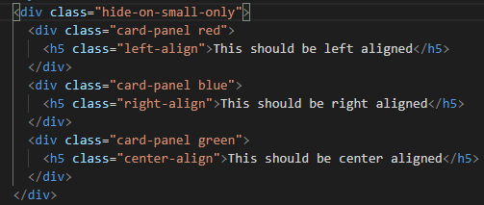
Examples - Alignment
Materialize Helpers
05-alignment.html

Slide 47
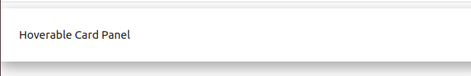
Examples - Hover
Materialize Helpers
06-hover.html

Slide 48
Examples - Truncate
Materialize Helpers
06-hover.html

Slide 49
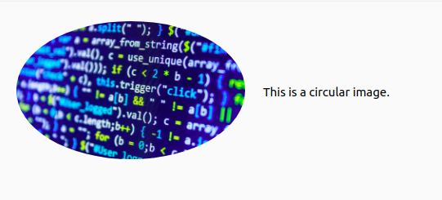
Examples - Images
Materialize Media
07-images.html

Slide 50
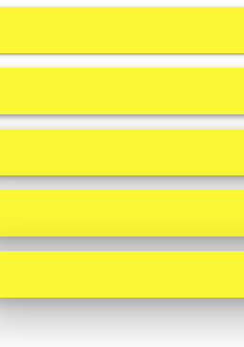
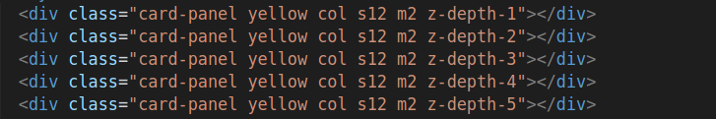
Examples - Shadows
Materialize Shadows
08-shadows.html

Slide 51
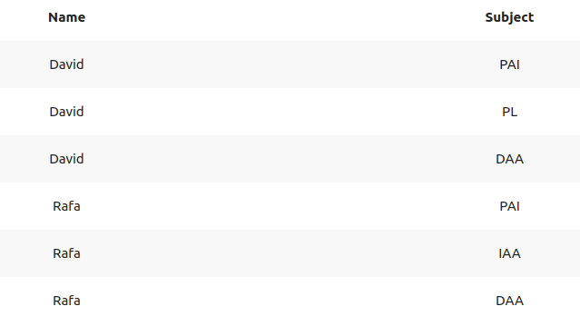
Examples - Tables
Materialize Table
09-table.html

Slide 52
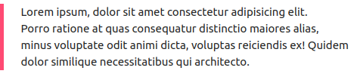
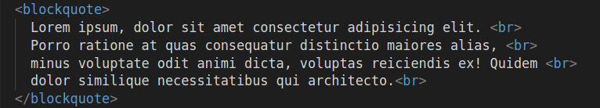
Examples - Blockquotes
Materialize Typography
10-blockquotes.html

Slide 53
Components

Slide 54
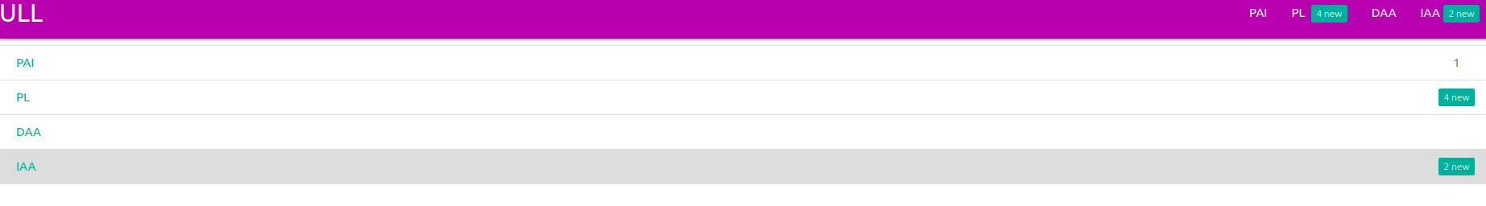
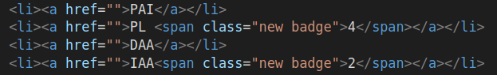
Examples - Badges
Materialize Badges
11-badges.html

Slide 55

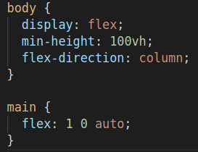
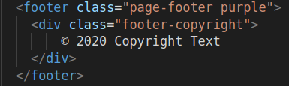
Examples - Footer
Materialize Footer
11-badges.html

Slide 56

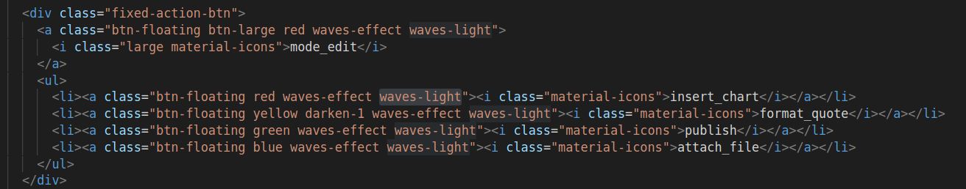

Examples - Floating buttons
Materialize Floating Action Buttons
11-badges.html

Slide 57


Examples - Cards
Materialize Cards
12-cards.html

Slide 58


Examples - Collections
Materialize Collections
13-collections.html

Slide 59


Examples - Icons
Material.io - Icons
Materialize Icons
13-collections.html

Slide 60

Examples - Navbar
Materialize Navbar
14-navbar.html

Slide 61
JavaScript

Slide 62


Examples - Carousel
Materialize Carousel
15-carousel.html

Slide 63



Examples - Collapsible
Materialize Collapsible
16-collapsible.html

Slide 64


Examples - Media
Materialize Media
17-media.html

Slide 65




Examples - Modals
Materialize Modals
18-modal.html

Slide 66


Examples - Parallax
Materialize Parallax
19-parallax.html

Slide 67


Examples - Sidenav
Materialize Sidenav
20-sidenav.html

Slide 68


Examples - ScrollSpy
Materialize ScrollSpy
20-sidenav.html

Slide 69

Examples - Waves-effect buttons
Materialize Waves
11-badges.html

Slide 70
Forms

Slide 71


Examples - Autocomplete
Materialize Autocomplete
21-autocomplete.html

Slide 72

Examples - Forms
Materialize Autocomplete
22-form.html

Slide 73

Examples - Templates
In order to see the Materialize potential, we also share these payment templates.
Materialize - Templates

Slide 74
Bibliography
Materialize CSS Documentation
Introduction to Materialize
Materialize course
Framework
Framework VS Own Code
Material.io
Material Design meaning
Material Design Information
GRID

Slide 75
Materialize CSS
Questions?

Slide 76
Materialize CSS
Programación de Aplicaciones Interactivas
Rafael Cala alu0101121901@ull.edu.es
David Valverde alu0101100296@ull.edu.es

